Slide 1
18ECO134T – Sensors and Transducers
Unit III : Session 9 : SLO 1
SRM Institute of Science and Technology
Notes:
Pl use Font Family : Arial Narrow
To enhance the teacher presentations and the overall comprehension of students, it allows to present their lessons in a more dynamic and effective way. Set a Learning Objective:
1. Write an Outline for Key Ideas
2. Give the Presentation About Education a "Why"
3. Share Techniques and Tips for the Topic
4. Teach With Visualizations
5. Use Animations Carefully

Slide 2
Scintillation Detector

Slide 3
Scintillation Detectors
Certain single crystals of organic or inorganic materials, activated glasses/liquids or plastic fluors have the property that when they receive high energy radiation, they produce very short duration light pulses or flashes called “Scintillations”.
These materials are known as Scintillators.

Slide 4
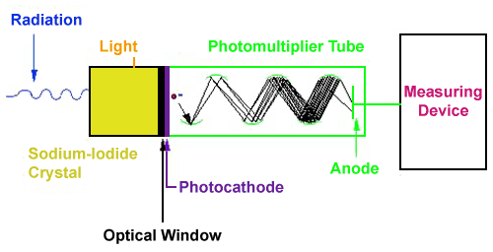
Scintillation Detector

Slide 5
Radiation Sensors-Charcterstics

